Slide 1
Marketing Strategies Based on Product Life Cycle
EEM UNIT-3

Slide 2
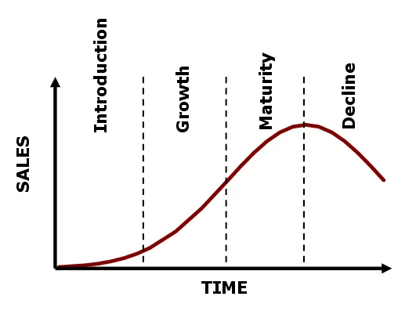
Marketing Strategies Based on Product Life Cycle

Slide 3
Marketing Strategies Based on Product Life Cycle
Marketing strategies can vary depending on the stage of the product life cycle. Here are some common strategies for each stage:
Introduction Stage:
Focus: Create awareness and establish a market for the product.
Strategies:
Heavy marketing and promotion to build brand awareness.
Offering promotional pricing or discounts to encourage trial.
Limited distribution to manage costs and gauge initial demand.
Educating consumers about the product's benefits and uses.

Slide 4
Marketing Strategies Based on Product Life Cycle
Growth Stage:
Focus: Increase market share and maximize revenue.
Strategies:
Expand distribution channels to reach more customers.
Enhance product features or introduce product variations to meet different customer needs.
Increase marketing efforts to maintain brand awareness and differentiate from competitors.
Adjust pricing to maximize revenue and market share.

Slide 5
Marketing Strategies Based on Product Life Cycle
Maturity Stage:
Focus: Maintain market share and maximize profit.
Strategies:
Focus on product differentiation and customer loyalty to maintain market share.
Price adjustments to defend against competitors or capture price-sensitive segments.
Cost-cutting measures to maintain profitability.
Explore new market segments or distribution channels to expand reach.

Slide 6
Marketing Strategies Based on Product Life Cycle
Decline Stage:
Focus: Manage decline and exit the market gracefully.
Strategies:
Reduce marketing and promotional expenses, focusing on profitable segments.
Consider product line extensions or repositioning for a last effort to revive sales.
Manage inventory and production costs to maximize profitability.
Plan for the end of the product life cycle, including phasing out production and managing customer transition to other products.
By aligning marketing strategies with the product life cycle stage, businesses can effectively manage their products and maximize their success in the market.

